Slide 1
Properties of Matter
Extensive properties depend on the amount of matter that is present.
Mass
Volume

Slide 2
Properties of Matter
Intensive properties depend on type of matter in a sample.

Slide 3
Identifying Substances
Substance
matter that has uniform & definite composition
Physical properties
quality of a substance that can be observed or measured without changing the composition of the substance

Slide 4
States of Matter

Slide 5
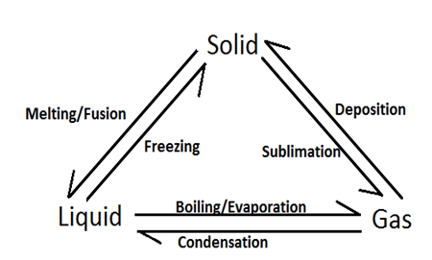
Changes in States of Matter

Slide 6
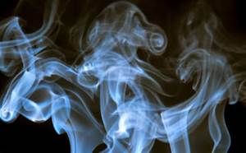
Gas vs. Vapor
Gas: Substances that are in a gaseous state at room
temperature.
Vapor: Gaseous state of a substance that is a liquid at room
temperature

Slide 7
Physical Changes
Properties of material change, but composition does NOT change
Can be classified as reversible or irreversible

Slide 8
Mixtures
A physical blend of two or more substances that do not change
Can be separated easily
Ways to separate
fingers
screen
paper filter
magnet

Slide 9
Classifying Mixtures
Heterogeneous Mixture
composition of mixture is not uniform throughout
oil and water
2 or more phases
suspensions
Phase: any part or a mixture with uniform make up and properties
Homogeneous Mixture
composition of mixture is uniform throughout
consists of only 1 phase
solutions

Slide 10
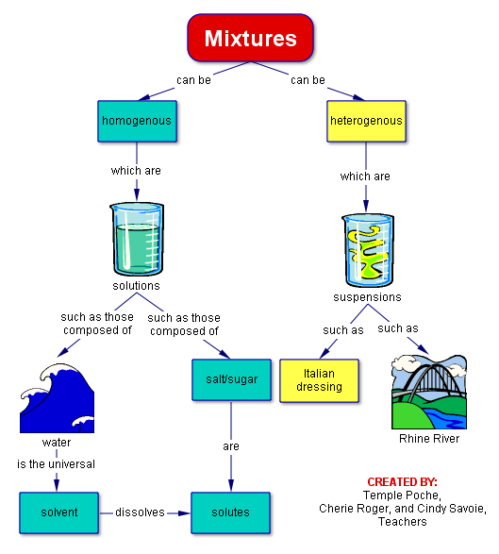

Slide 11
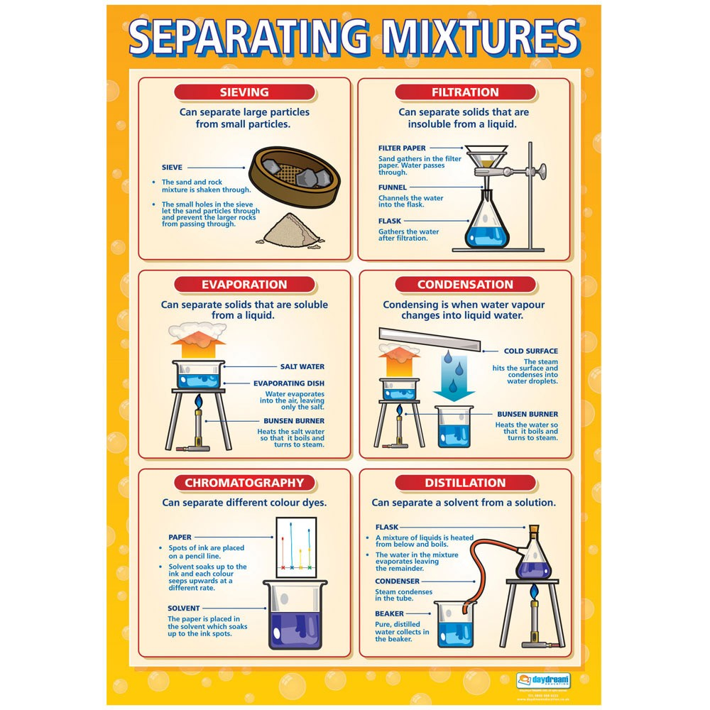

Slide 12
Elements & Compounds
Element: simplest form of matter that has a unique set of properties
e.g. C, H, O, N
Compound: substance that contains two or more elements
chemically combined in a fixed proportion.
e.g. CO2, H20, C6H12O6
Compounds can be broken down into simpler substance by chemical means, but elements cannot.

Slide 13
Breaking Down Compounds
Physical methods are used to separate mixtures, but cannot break a compound into simpler substances.
Chemical changes are changes that produce matter with a different composition than the original matter.

Slide 14
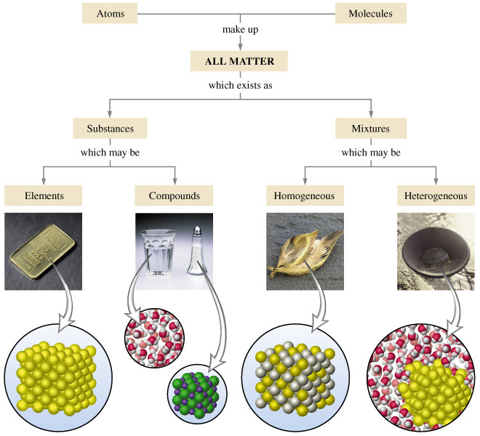
Substances vs. Mixtures

Slide 15
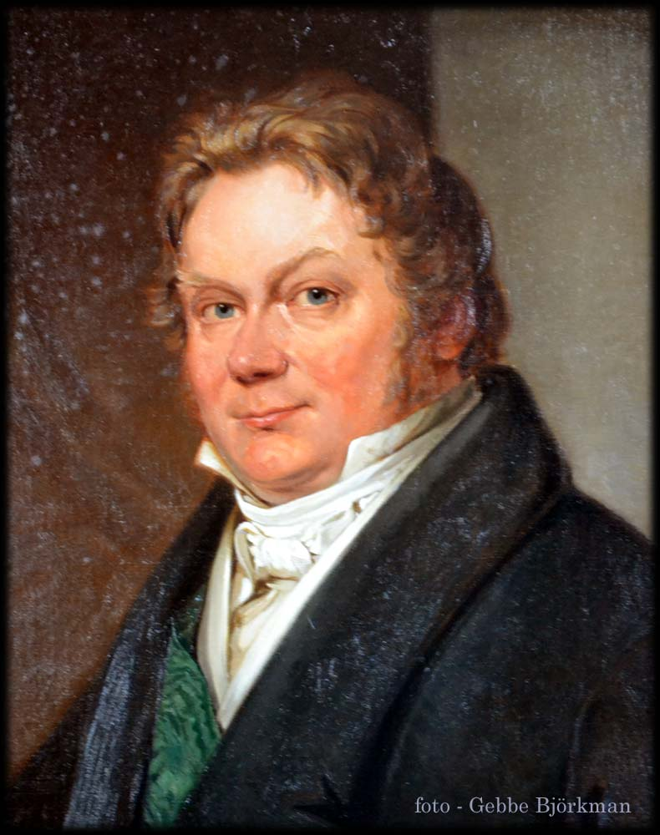
Symbols & Formulas
Chemical symbols represent elements, chemical formulas represent compounds.
Jons Jacob Berzelius (1779-1848)
Swedish chemist that developed symbols for
elements
Symbols were based on Latin names of elements
First letter of chemical symbol is capitalized,
second letter (if there is one) is lowercase

Slide 16
The Periodic Table

Slide 17
Chemical Formulas
Chemical symbols allow a shorthand way to write the chemical formulas of compounds.
Subscript numbers tell the proportions of elements in the compound
Chemical formula for caffeine

Slide 18
Chemical Changes
The composition of matter always changes during a chemical change.
A new substance is formed.
Words associated with chemical changes:
Burn
Rot
Rust
Decompose
Ferment
Explode
Also called chemical reactions

Slide 19
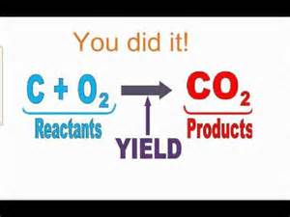
Chemical Reactions
Chemical reactions occur when one or more substances change into one or more NEW substances.
Reactant: starting material(s)
Product: substance(s) made in the reaction

