Slide 1
Transitions Silver

Slide 2
Soft Skills
Skills that allow students to be successful in their educational careers
Academic skills are NOT the only skills needed to do well in college
Five areas of soft skills
1. attendance
2. preparation
3. follow-through
4. communication
5. responsibility

Slide 3
Starting a College Course
Getting to know the professor
Sending a get to know you email
Introduce/speak with the professor
Know the office hours of your professor
Know tutoring hours and phone numbers

Slide 4
Revise Syllabus
Note important dates
Put dates into phone or organizational system
Set reminders or alerts

Slide 5
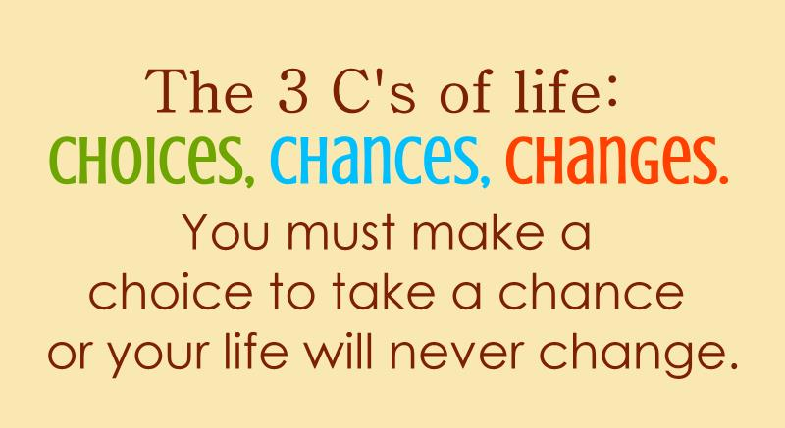

Slide 6
Getting to Know Fellow Classmates
How to introduce yourself
Ask questions
Where are you from?
What other classes are you taking?
What are you majoring in?
Comment on clothing, accessories, etc.
Talk about the weather, the college, your family

